Slide 1
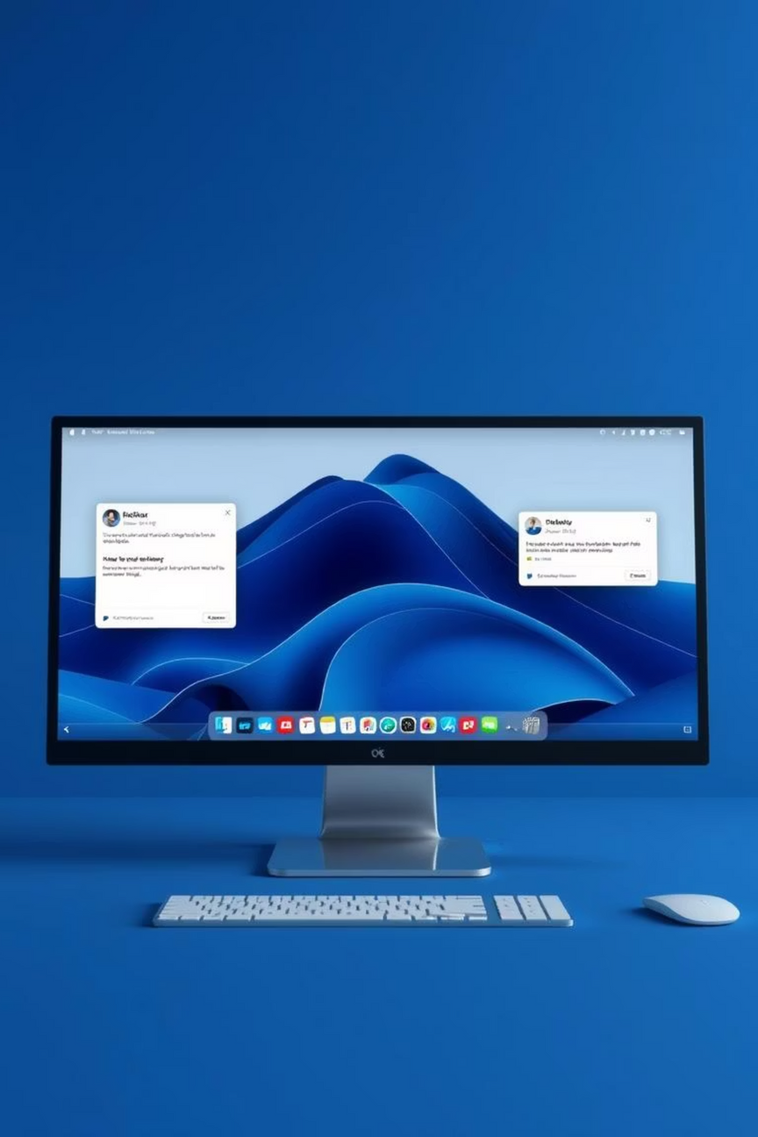
Task & Reminder Notifier
Your Personal Desktop Assistant
Notes:
1

Slide 2

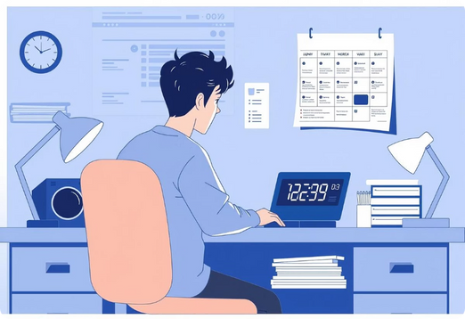
Abstract
In today's fast-paced world, staying organized is crucial. This project addresses the need for a simple, yet powerful, desktop notification application. It provides users with a reliable way to schedule custom reminders, ensuring important tasks and events are never missed.
Notes:
2

Slide 3
Key Features
1
2
Custom Notifications
Cross-Platform Support
Set titles, messages, times, icons, and sounds.
Seamless notifications across Windows, macOS, and Linux.
3
4
Persistent Storage
Background Operation
Notifications saved in JSON format for continuity.
Threading ensures a responsive UI without freezing.
Notes:
3

Slide 4

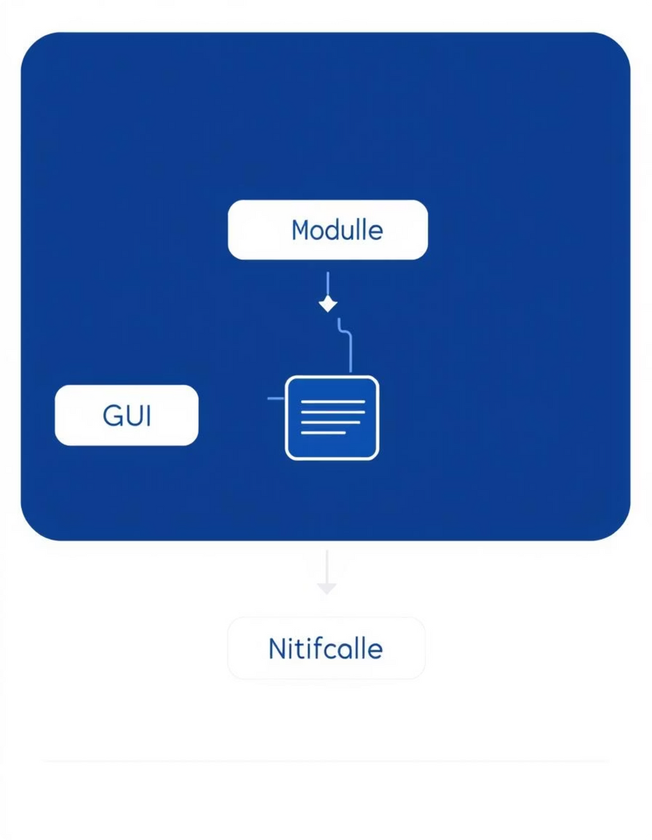
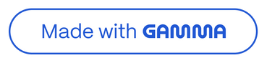
System Architecture
The application is structured into distinct modules: the GUI for user interaction, a storage module for data persistence, and a notification module handling cross-platform alerts.
Notes:
4

Slide 5

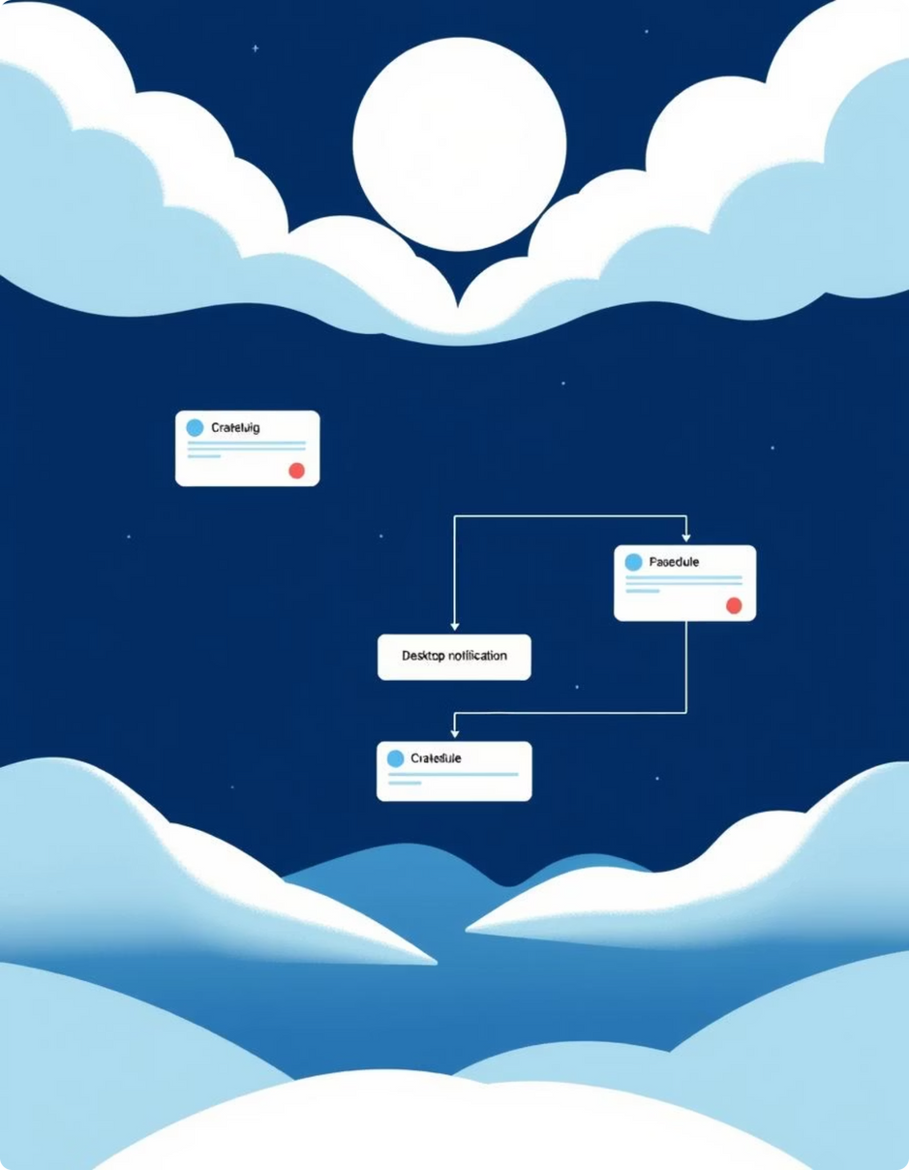



Notification Workflow
User Input
Define notification details in the GUI.
Schedule & Store
App schedules and saves notification to JSON.
Trigger & Notify
At set time, notification is displayed.
Notes:
5

Slide 6
Technical Stack
Core Framework
Packaging & Persistence
Tkinter: For intuitive and responsive GUI development.
PyInstaller: To create standalone executable files.
JSON: For efficient and readable data storage.
Utility Libraries
Concurrency
Pillow: For image processing, including PNG-to-ICO conversion.
Threading: To ensure smooth background operations.
Plyer: For abstracting cross-platform notification calls.
Winotify: For native Windows 10 toast notifications.
Notes:
6

Slide 7



Advantages
Enhanced Productivity
High Customization
Broad Compatibility
Never miss a deadline or important event again.
Tailor notifications to your exact needs.
Works seamlessly across major operating systems.
This application stands out by offering a highly customizable, reliable, and cross-platform solution for desktop notifications, significantly boosting user productivity.
Notes:
7

Slide 8

Thank You
For your time and consideration. I am confident that "Task & Reminder Notifier" demonstrates strong technical skills and practical problem-solving.
Notes:
8

